Slide 1
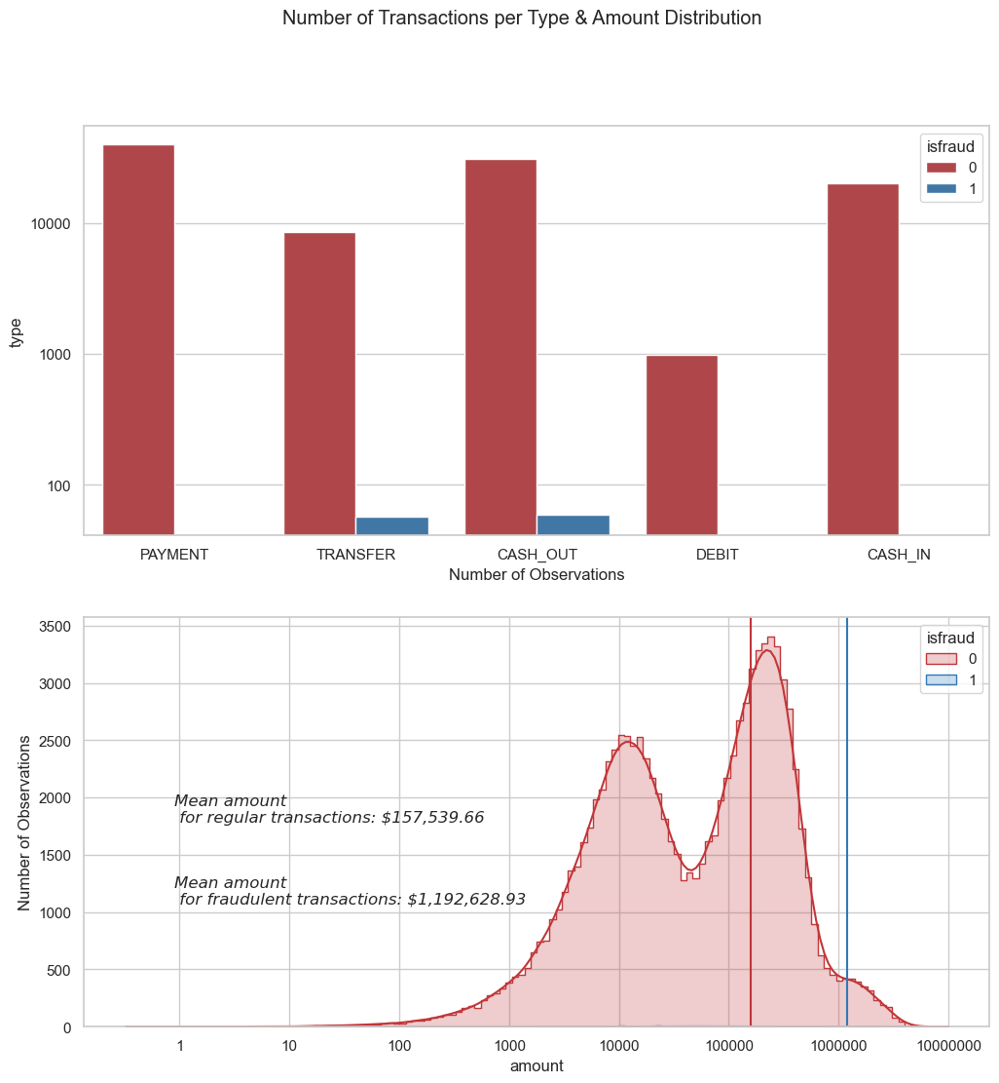
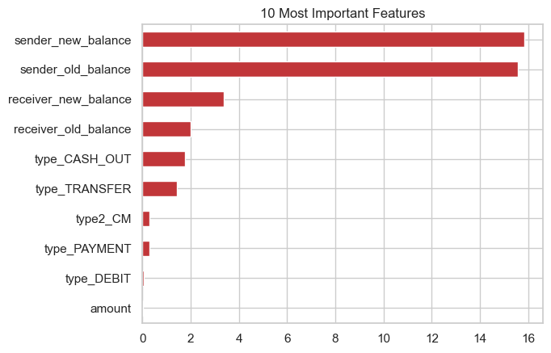
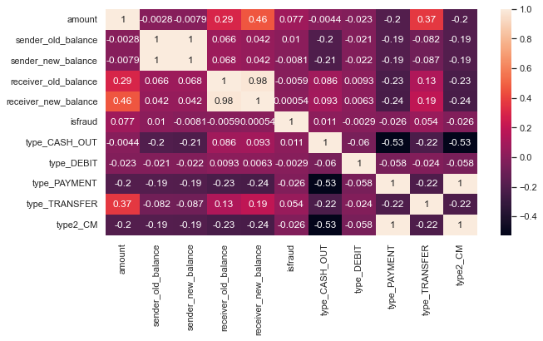
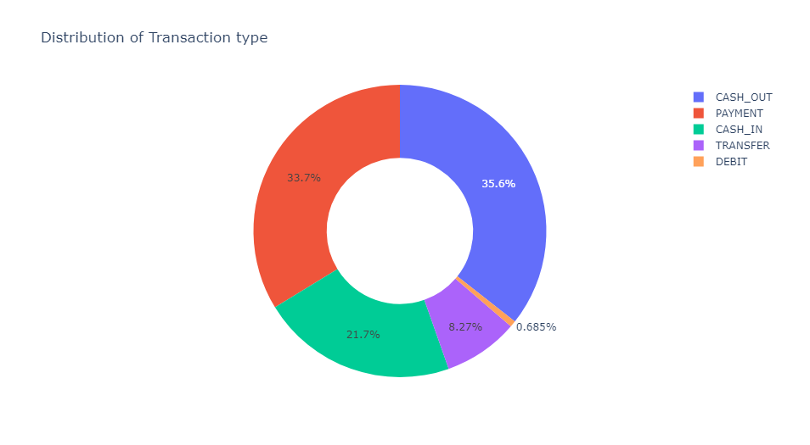
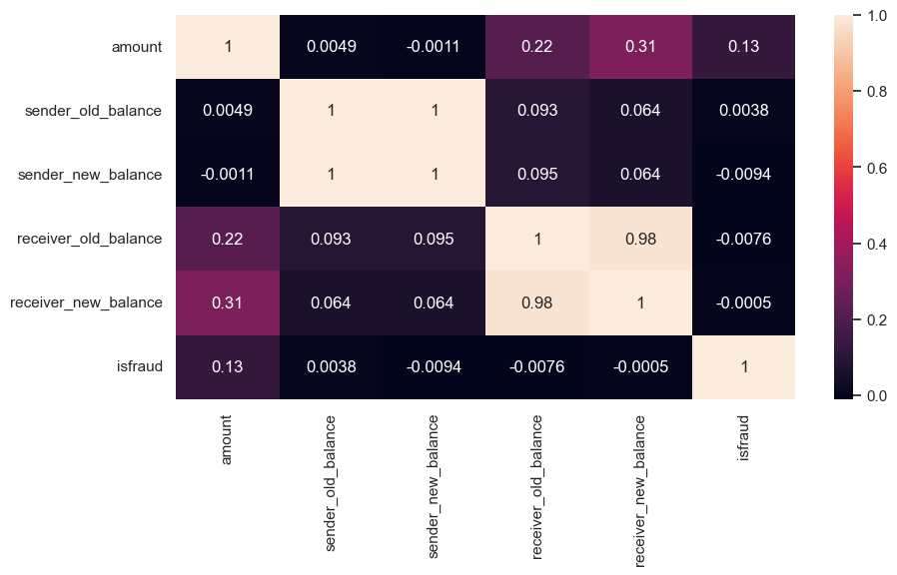
Financial Payment Services Fraud Prediction
Introduction
Financial payment services are critical to the global economy, allowing individuals and businesses to quickly and securely exchange funds. Unfortunately, these services are also vulnerable to fraudulent activities that can cause significant financial losses for both customers and financial institutions.
Exploratory Data Analysis
Results and Discussion
Decision Tree has the highest accuracy of 99.91% compared to all others.
Random Forest ranks the second best.
Important features are sender new, old balance, receiver new, old balance. The analysis identified the most important features for accurately predicting fraudulent transactions.
These features provide valuable insights into the transaction patterns of customers.
Business Implications
Financial institutions can more accurately identify potential fraudulent transactions, reducing financial losses and maintaining trust in the payment system.
Real-time fraud detection allows financial institutions to respond to potential fraud incidents more quickly, reducing the likelihood of financial losses and improving customer satisfaction.
Our algorithm can have the ability to implement a robust fraud detection system, financial institutions can ensure that they are compliant with regulatory requirements and avoid potential fines and legal issues.
Objective
The project aims to analyze transaction data to identify patterns and anomalies that are indicative of fraudulent behavior.
The research aims to explore various machine learning methodologies and classifiers to determine the optimal model based on key metrics.
The research also aims to explore various machine learning methodologies and classifiers.
To determine the optimal model out of the 5 based on key metrics like: Accuracy statistics, Correlation Matrix, F-measures, Recall and Precision values.
The objective is also to provide financial institutions with a powerful tool to prevent financial losses and maintain trust in the payment system.
Model Name | Accuracy | AUC | Precision | Recall | F1-Score
Logistic Regression | 99.9% | 98.3% | 89.82% | 39.7% | 55.13%
Random Forest | 99.9% | 89.6% | 80.5% | 79.3% | 79.9%
Decision Tree | 100% | 94.1% | 89.7% | 88.3% | 89.3%
Future Studies
Apply same algorithms and methods on larger dataset to confirm the results obtained via this database.
I plan to apply other machine learning algorithms (Neural Networks, XgBoost, etc) with more transactions to obtain higher accuracy.
Additionally, could explore the cost-benefit analysis of implementing a fraud detection system. The analysis could include the costs of implementing the system, the costs of fraud losses and the potential benefits.
Most fraudulent transactions occur in the categories Cash-Out & Transfer.
Data Pre-Processing
As, the dataset is imbalanced, used down sampling technique to prevent the model from being biased towards the majority class.
Data Description
Data Source: The data was publicly available in Kaggle.
The dataset consists of 63620 observations and 11 variables in all.
It has combination of numeric and categorical data.
isFraud column is the dependent variable.
The distribution of positive and negative classes is extremely unbalanced, which is the key technical difficulty it presents for forecasting fraud.
Methodology
The project uses various machine learning models to identify fraudulent transactions.
Logistic Regression
Random Forest
Decision Tree Method
Conclusion
Through this research, it showed that despite the high-class imbalance, it is possible to identify fraudulent transactions in financial payments data with extremely high accuracy.
The developed framework can successfully detect fraudulent transactions in financial data. This framework will help understand the nuances of fraud detection such as the creation of derived variables that may help separate the classes, addressing class imbalance and choosing the right algorithm.
After an accurate comparison between our models, it is found that Decision Tree achieved a higher efficiency and outperformed all other models.
Bargavi Kongara

